Slide 1
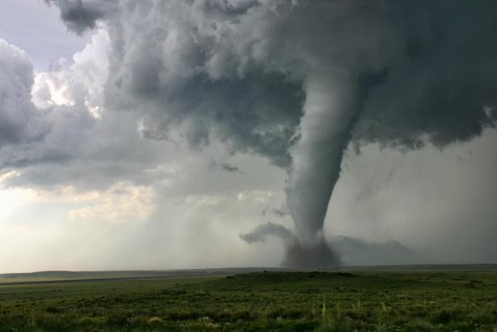
US Tornadoes
Fabi Estrada
Uzor Francis
Ally Blitch
Ivette Reese
EF-5 Tornado devastated Moore Oklahoma, Oklahoma City suburb on May 20, 2013.
Horrific EF-5 tornado in Moore, Oklahoma: May 20, 2013 (youtube.com) (play at 12:57)

Slide 2
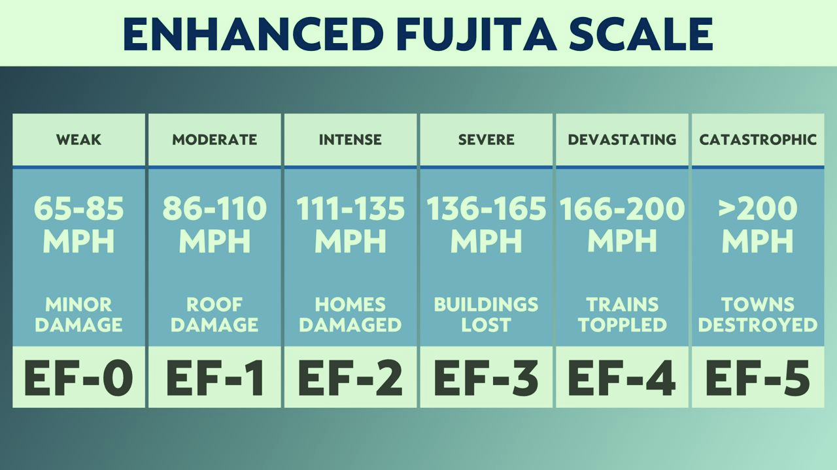
Introduction
We chose the US tornado data because it had a wide breadth of data and our curiosity about how tornados are categorized. We found out that the Enhanced Fujita scale (EF) relies on wind-speed to determine a tornado magnitude rating, where 0 means a weak tornado while 5 means a catastrophic tornado.
Our project aimed to uncover patterns of tornadoes over the last seven decades. First, we cleaned the tornados CSV file, loaded the data into a SQLite database, then had the Flask app listened for the request. The Flask parsed out the user’s input, turned it into a SQL statement, select * from the database. Once we received the data, we created the three visualizations.

Slide 3
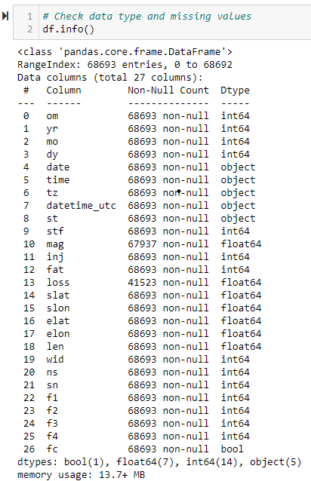
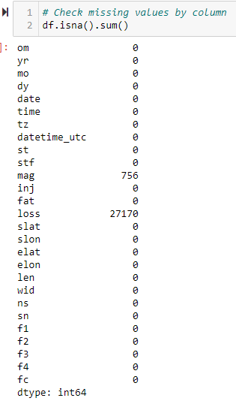
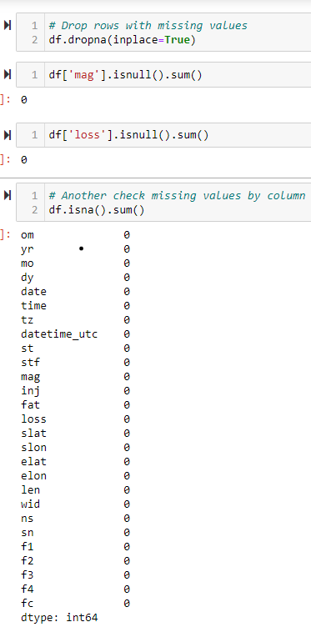
Data Engineering
We started by conducting our exploratory data analysis using Jupyter Notebook. We did not have any null values but dropped one identified duplicate, 756 magnitude ratings missing values and 27,170 loss input missing values.

Slide 4
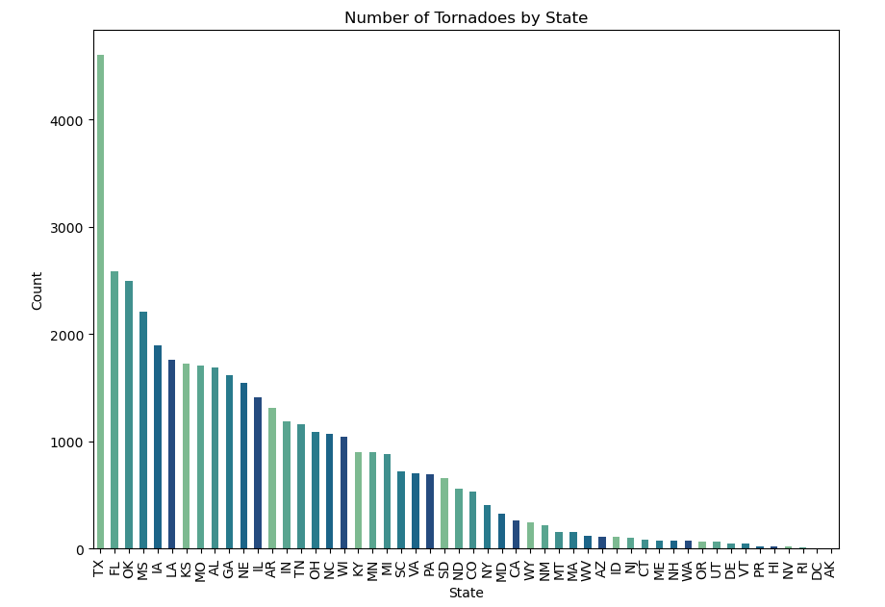
Visualizations (1 of 2)
Using Matplotlib library we created a bar chart that shows the number of tornadoes by state from the state with most tornados to the state with less tornados.

Slide 5
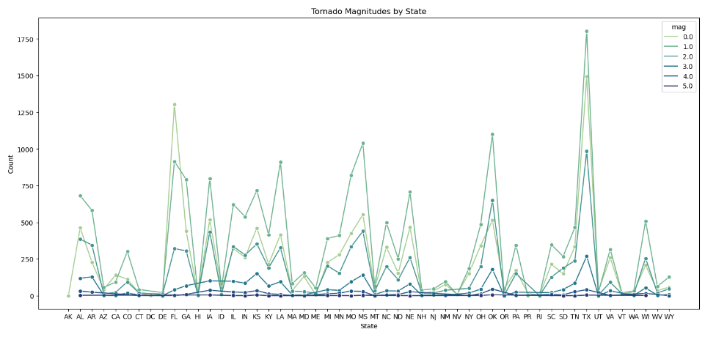
Visualizations (2 of 2)
We also created a line chart that displays the number of tornadoes by state and magnitudes from 0-5.

Slide 6
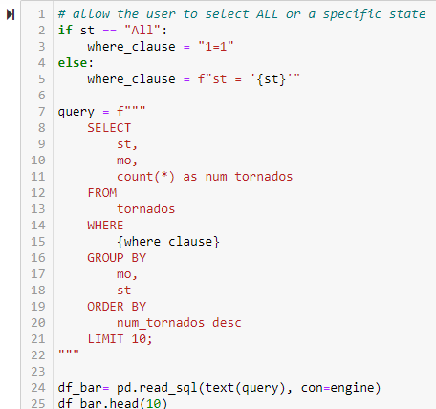
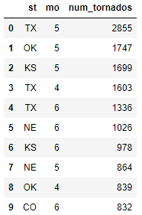
Visualizations (3 of 3)
Then we loaded and stored the cleaned (transformed) data to an SQLite database.
Ran the above query which automatically created an SQLite file.

Slide 7
The SQLite file will use Flask to serve data from the CSV database to one route and serve index.html
when the dashboard is visited. Added the Plotly library to the app.js JavaScript code.
The Dropdown is established by state once the state is selected from the dropdown then bar and line charts and the map update.

Slide 9
Findings
Between 1950 and 2022 there were 68,693 tornados.
2. The highest concentrations of US tornadoes occurred in Texas, Florida, Oklahoma, Mississippi, Iowa and Louisiana.
3. Texas had the highest concentration of tornadoes with 4,601 tornados, while Alaska had 1 the lowest concentration of tornadoes.
4. The magnitude ratings show a strong upward trend where magnitude is 0 and 1. The state of Texas with the higher number of tornadoes, reported the 1 rating recurring more.
5. Texas, Oklahoma, Iowa and Kansas each reported 5 tornadoes of magnitude rating 5.
6. May and June were the months with the highest concentration of tornadoes, while November, December and January account for the smaller number of tornadoes.

Slide 10
Conclusions
1. The US tornadoes (1950-2022) magnitudes upward trend were 0 and 1.
2. Most of the tornados occurred from the middle to the east states.

Slide 11
Limitations/Bias
Accounting bias – according to the American Meteorological Society the reporting of tornado occurrence is recorded at the county level. All tornadoes regardless of size/EF rating are counted. However, because of selective reporting weak tornados with minimum impact/losses may go underreported.

Slide 12
Future Work

Slide 13
Work Cited
https://www.kaggle.com/datasets/sujaykapadnis/tornados/data
Horrific EF-5 tornado in Moore, Oklahoma: May 20, 2013 (youtube.com)
https://www.spc.noaa.gov/wcm/data/2008bams.pdf The American Meteorological Society

